Slide 1
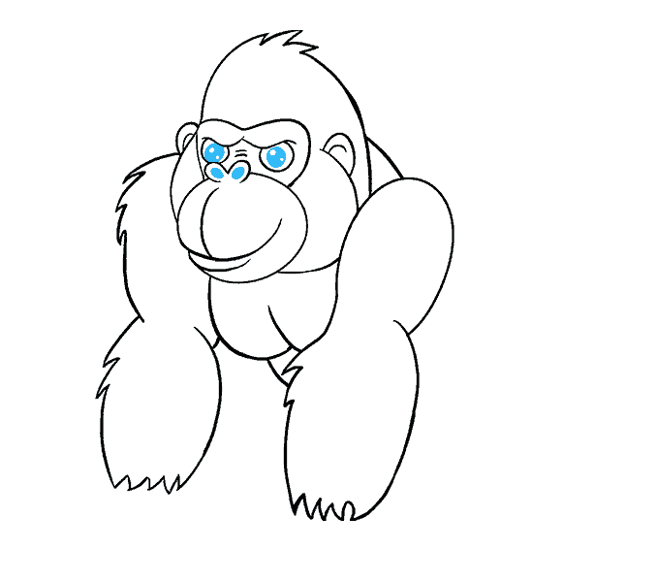
Funny Gorilla 诙猩猩-IT培训
Your success is our success
Agile Testing

Slide 2
What is agile testing
https://www.sealights.io/agile-testing/agile-testing-8-principles-7-challenges-and-how-to-master-them/

Slide 3
8 Principles
Continuous testing
Continuous feedback
Involving the whole team
Quick feedback
High-level software quality
Less documentation
Test-driven
Customer satisfaction

Slide 4
Testing Challenges in Agile How to Master Them

Slide 5
Changing Requirements

Slide 6
Not Enough Information

Slide 7
Continuous Testing

Slide 8
Technical Skills

Slide 9
Frequent Regression Cycles

Slide 10
Lack of Communication
If communication between developers, testers and the product owners is lacking, agile testing will simply not work.

Slide 11
No Quality Measurement

Slide 12
References

Slide 13
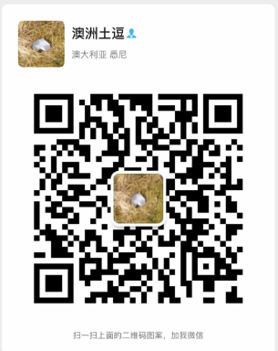
Contact
Your success is our success
Mail: info@funnygorilla.com.au
Linkedin: https://mt.linkedin.com/in/songqing-gu-2ba9034b/de
Web Chat: FunnyGorilla
Phone: 0420891343

